Slide 1
Programming Principles and Techniques
PROGRAMMING LANGUAGE
& VARIABLES
Notes:
1-13

Slide 2
Learning Outcomes
By the end of this session, you should be able to:
Differentiate three types of programming languages;
Explain the history of C languages;
Describe the development environment of C programming;
Define variable and its usage in programming;
Identify valid or invalid variables according to the rule in naming variables; and
Write syntax to declare and initialise variables.
Notes:
1-13

Slide 3
Introduction
To command a computer to do a task, the given instructions must be in machine language
Writing programs in machine language is not an easy task for programmer
To overcome this problem, programming languages have been simplified to be more easier to be written
Notes:
1-13

Slide 4
Programming Language Types
Machine Language
  Programs written is normally stated in binary numbering system (0 and 1) or in hexadecimal numbering system.
Assembly Language
  Programming in machine language is difficult and slow.
  To overcome it, assembly language is introduced by manipulating mnemonic codes to represent the machine language.
Notes:
1-13

Slide 5
Programming Language Types
High Level Language
  Machine language and assembly language are machine-dependent languages.
  To overcome it, a language that is machine-independent is needed to make it easier for programs to be transferred from one computer to another.
Notes:
1-13

Slide 6
Programming Language Types (cont.)
  This language resembles the natural language more and it is easier to read and understand.
  It must be compiled into machine language before it can be executed. The compilation is done using compiler.
  Examples: C, C++, Ada, Lisp, Pascal, Fortran, COBOL
<number> - 13
Notes:
1-13

Slide 7
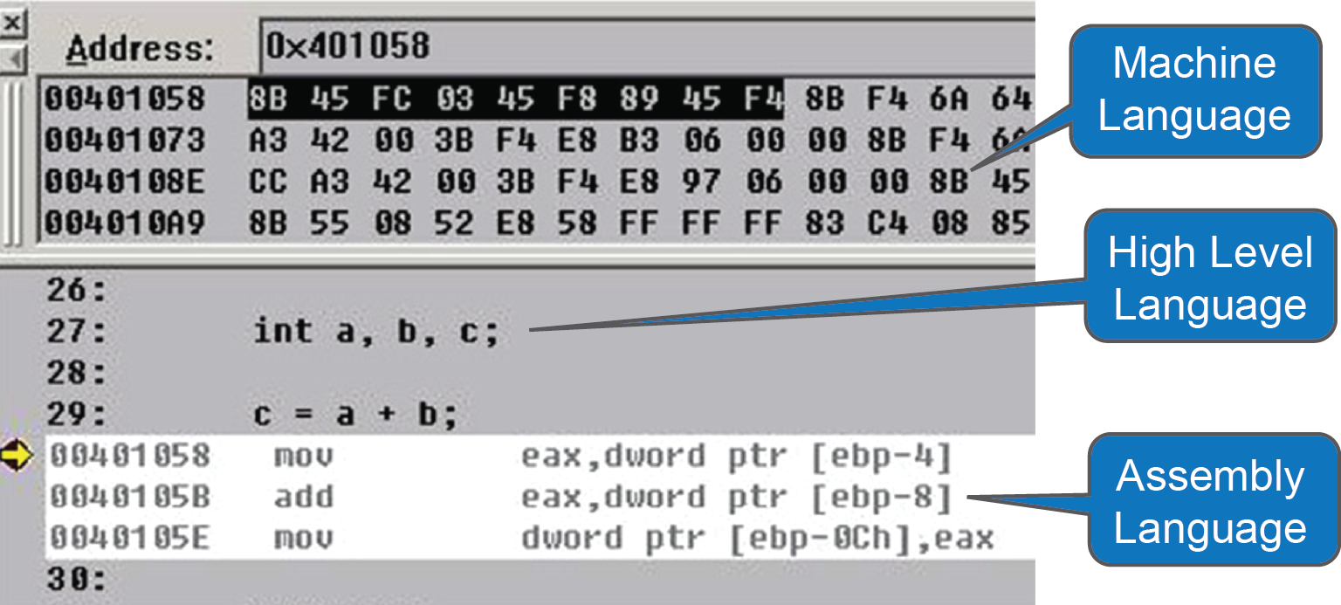
Programming Language Types
(Source: http://www.uigarden.net/english/the-application-of-model-matching-principle-in-user-interface-design-part-2)
Notes:
1-13

Slide 8
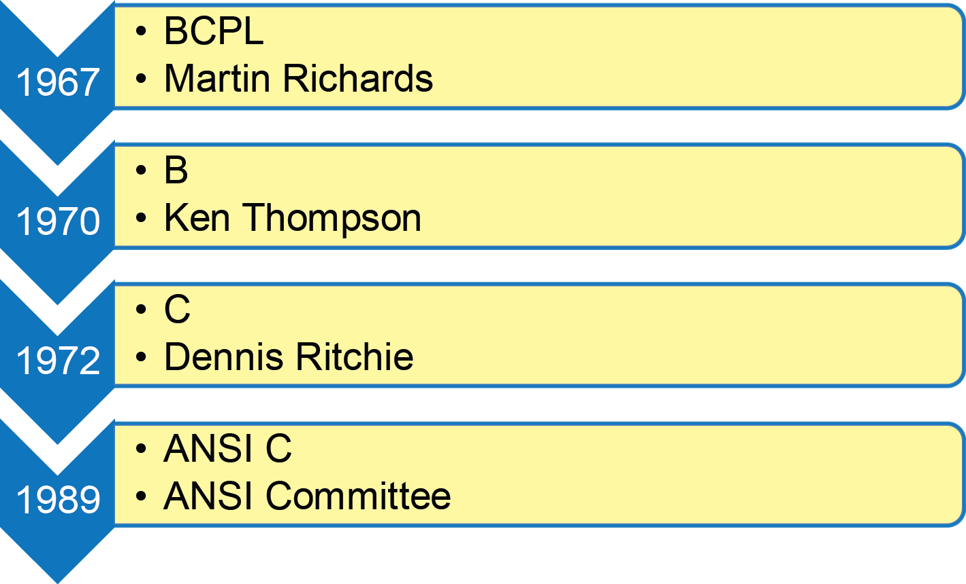
Brief History of C Language
Notes:
1-13

Slide 9
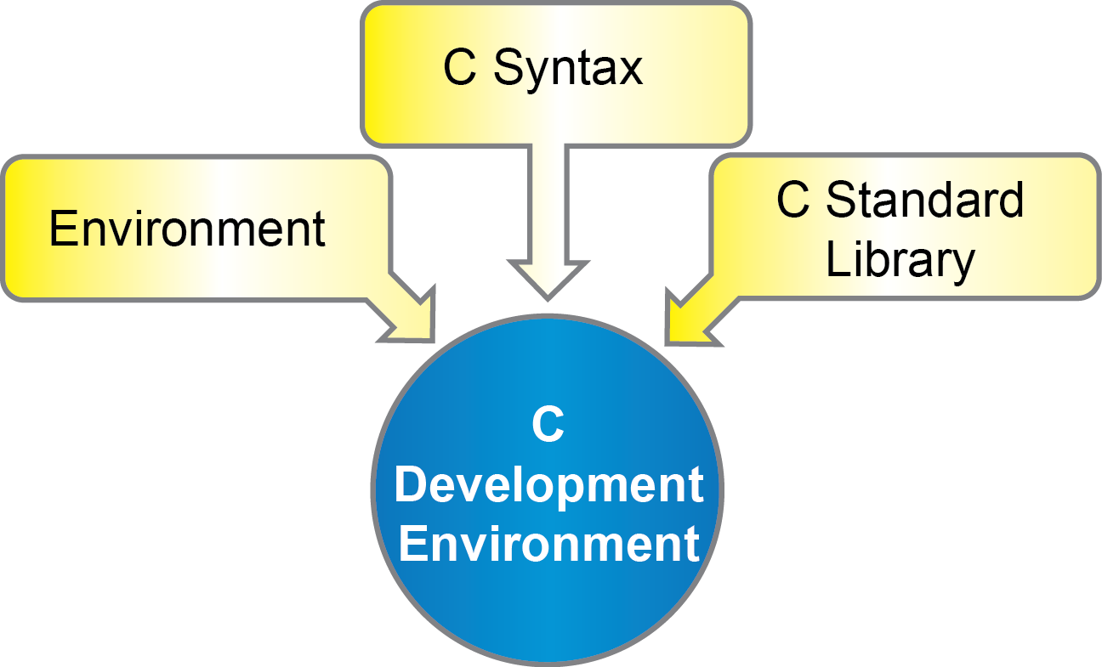
C Development Environment
Notes:
1-13

Slide 10
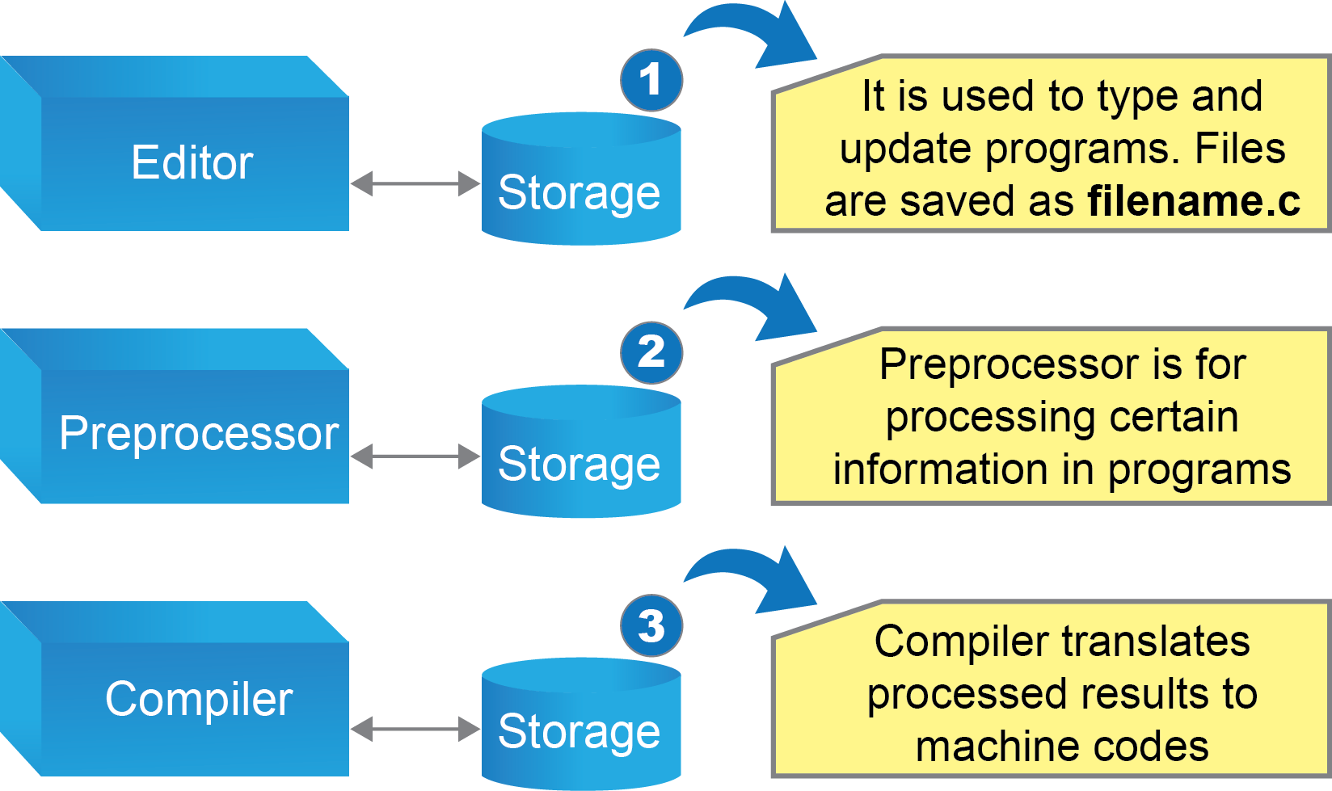
C Programming Environment
Notes:
1-13

Slide 11
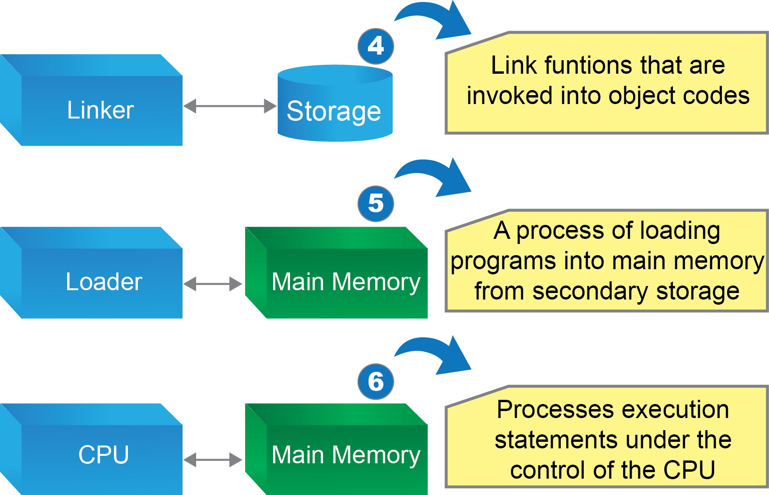
C Programming Environment
Notes:
1-13

Slide 12
Sample C Program
/* This program will print a greeting
Welcome to UNITAR! */
#include <stdio.h>
void main(void)
{
printf(“Welcome to UNITAR!\n”);
}
Notes:
1-13

Slide 13
Variable Naming
Variable is basically a name, given by a programmer, to represent a piece of data within a certain program.
It can be declared and initialised at the beginning of a program.
To declare a variable, we need to associate a name and the data type to represent a particular value.
Notes:
1-13

Slide 14
Rules to Name a Variable
Variable name can only begin with a letter, or an underscore ( _ ), and followed with the other letters or digits. However, beginning variable with underscore is not recommended for certain operating systems.
Variable name cannot start with a digit or a number.
Notes:
1-13

Slide 15
Rules to Name a Variable (cont.)
Reserved words in C cannot be used as a variable name.
You cannot have a space between two words in a variable. However, you can use underscore between two words, or capitalised the first letter of the second word.
Variable name cannot be written more than 31 characters.
Notes:
1-13

Slide 16
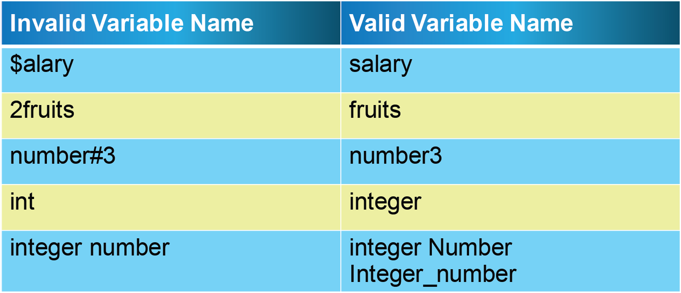
Examples
Notes:
1-13

Slide 17
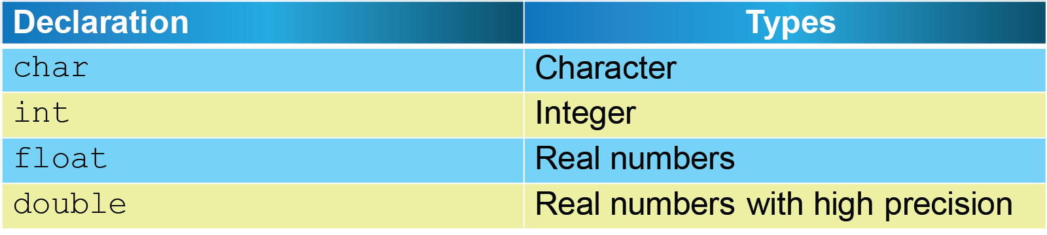
Variable Types
Notes:
1-13

Slide 18
Variable Declaration
General Syntax:
    data_type variable_name;
Example:
    int mark1, mark2, mark3;
    double averageMarks;
    char grade;
Notes:
1-13

Slide 19
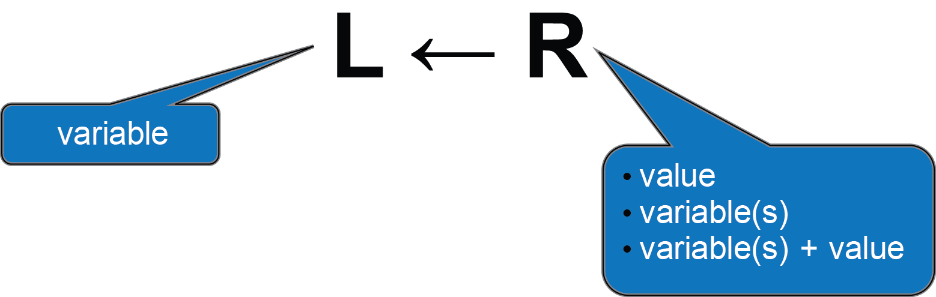
Variable Assignment
Examples:
total = 10;
total = num1 + num2;
total = num1 + 10;
Notes:
1-13

Slide 20

Variable Assignment
total = 10;
In C, the above statement is read like this:
The value of 10 is assigned to a variable named “total”.
Notes:
1-13

Slide 21
Summary
Three types of programming languages: machine language, assembly language, and high level language.
C development environment consists of editing, pre-processing, compiling, linking, loading and executing.
Variables are named as an identifier that are declared by the user.
Variables can be used to keep data and the calculation results or logic manipulations.
Notes:
1-13

